Slide 1
Keen cal
An app for managing schedules, appointments, gatherings and events
Business meetings
Social events
Manage classroom activities
Plus anything else you can think of

Slide 2
Business
Schedule a meeting
Once a meeting is scheduled and participants are added there are several useful features:
Add contacts to have reminders go out
Get multiple reminders yourself: Meeting in 1 hour; Meeting in 5 minutes
Automatically silence your device at meeting start then enable at the end

Slide 3
Social
Plan or join an event
You can attend someone’s event or host your own:
Never forget birthdays or anniversaries
One stop to see messages from guests; “Running late, be there in 10”
Easily send messages to all your guests; “Parking lot is full, there is room around the corner”

Slide 4
school
Manage all learning activities
Especially helpful to coordinate class and work or social events:
Receive reminders when class starts plus due dates for tests and reports
Automatically turn off your ringer at start and turn it back on at the end
Never forget an assignment

Slide 5
Key features
Do not disturb
Automatically turn device on / off
Email directly from calendar
Send a message while viewing schedule
Call or text right from event
Send a group message or call a single participant
Get responses directly
Indicators when a participant contacts you

Slide 6
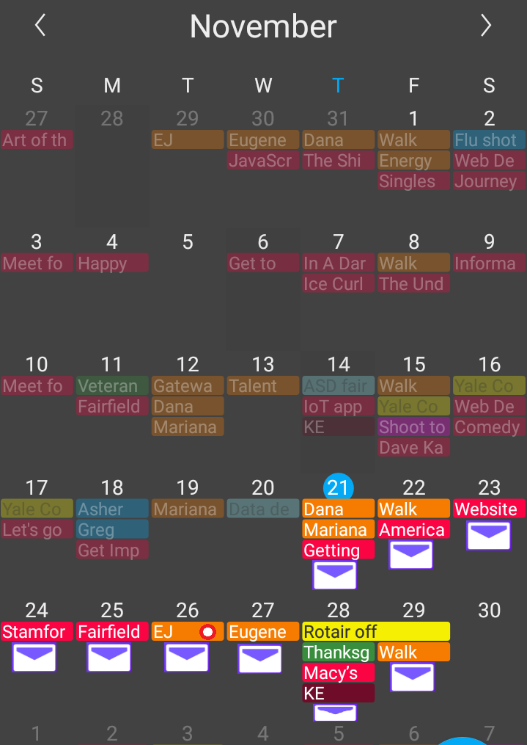
Month view
The month view allows easy access to email to all participants.
Also an indicator will appear when someone assigned to the event has reached out to you.

Slide 7
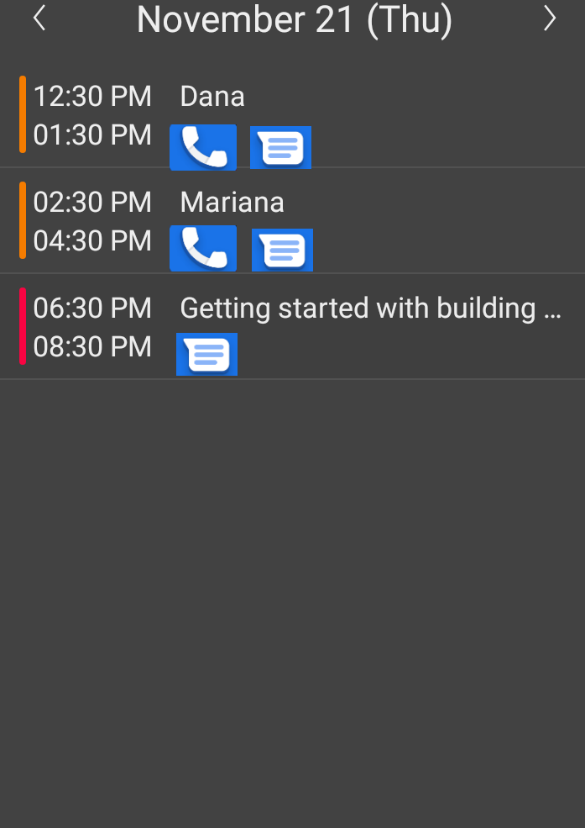
day view
The day view allows easy access to text all participants or if it’s a single person engagement the phone option is available.

Slide 8
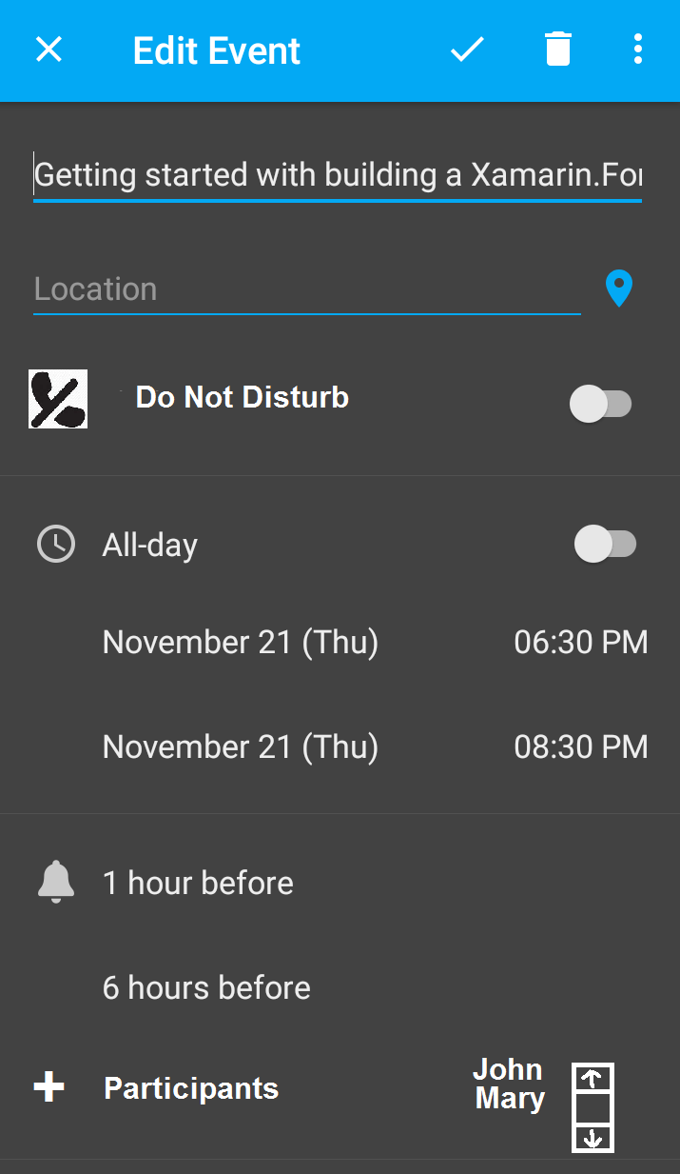
event view
When creating or editing an event there is an option to add participants from your contacts. Also you can set your device to go into Do Not Disturb mode at the beginning of the event and return to the prior status at the end.

Slide 9
Challenges
Incorporating texting – are there issues working with the actual texting app
Turning the ringer back on – what happens if the app is closed?
Exporting the calendar – does the most common format support the additional functionality

